Slide 1
Addressing Behavioral Health Needs in the Workforce

Slide 2
TODAY'S DISCUSSION
TOPICS TO COVER
Introduction
Timeline
Research
Feedback and next steps

Slide 3
BEHAVIORAL HEALTH
Refers generally to mental health and substance use disorders, life stressors and crises, and stress-related physical symptoms.
Behavioral health care refers to the prevention, diagnosis and treatment of those conditions.

Slide 4
OUR GOAL
To create a healthy work environment with increased retention where behavioral health of employees is a priority and resources are provided for employees to utilize.
WHAT DOES THIS LOOK LIKE:
We are looking at providing an application that you would be able to download on your phone. Each application has a different range of features they offer.

Slide 5
WHY NOW?
APPARENT NEED NATIONALLY
SPECIFIC NEED IN KANSAS
WE ARE IN A CRUCIAL TIME
1 in 5 adults in the U.S. has a clinically significant mental health or substance use disorder.
Substance Abuse and Mental Health Services Administration (SAMHSA)
Kansas is last in the nation in mental health rankings by state.
Rural areas lack access
Mental Health America
From 15 March 2020 through 31 August 2021, 51 Kansas local health officials (representing 41 counties) left their due in part to stress, burnout and anxiety
Cain, Cristi et al. 2022

Slide 6
What Can Solutions Look Like?
Skill Building - Guided content is offered by many applications. This gives you the opportunity to learn more about yourself and implement strategies you can apply to your current needs. This can be anything from opportunities to learn more about certain well-being topics, using guided breathing or meditation, self-care, etc.
24/7 Chat - Some allow for texting at any point during the day or night. You can talk with a real person and they can give you insight and support in the form of coaching. Should you choose to utilize therapy option through the app, the person you are chatting with will also communicate with the therapy provider chosen for you so you do not have to start from scratch.
Family Support - Some apps provide support to members of your family at no additional cost. This means they would have access to all the resources such as guided meditation, therapy, psychiatry, coaching, 24/7 chat, etc.
Therapy - Oftentimes, there can be long wait times and limited access to mental health providers in many areas of Kansas. This can create barriers to access in many counties. Some of these apps would give you access to online therapy with a licensed provider you can utilize for free.
Psychiatry - Similar to therapy, long wait times or the lack of psychiatry services are a huge barrier to access in many communities. Some apps provide sessions with psychiatrists for medication and medication management for symptoms associated with ADHD, anxiety, depression, etc.

Slide 7
TIMELINE
PAST
TODAY
FUTURE
Established goal and needs
What do LHDs want
Extensive research on solutions
Present reserach and findings
Gain feedback and insight
Develop areas of future research
Present for funding consideration
Ensure utilization of product
Track for effectiveness

Slide 8
OUR FINDINGS - LHDS

Slide 9
OUR FINDINGS - LHDS

Slide 10
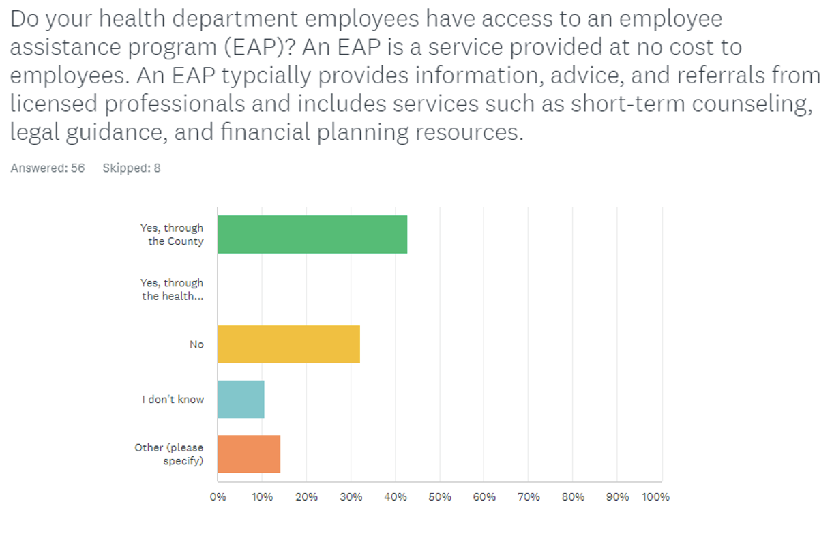
OUR FINDINGS - LHDS

Slide 11
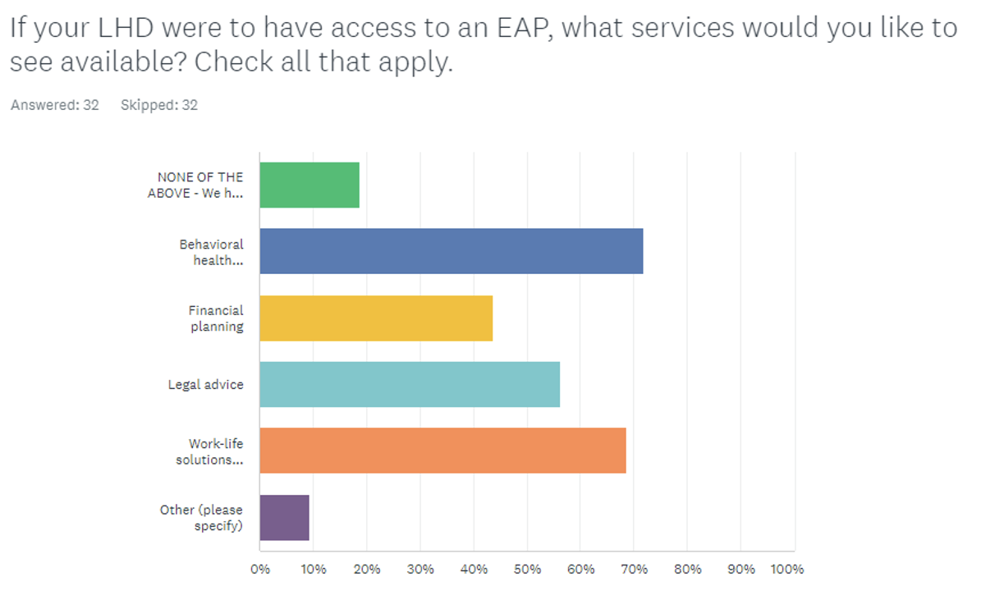
OUR FINDINGS - LHDS

Slide 12
OUR FINDINGS - PRODUCT

Slide 13
OUR FINDINGS - PRODUCT

Slide 14
QUESTIONS?
SUGGESTIONS?
Email Bryce.Liedtke@washburn.edu

