Slide 1

Advancing the Adoption and Use of a Uniform Chart of Accounts in Public Health
Public Health Activities & Services Tracking (PHAST)
University of Washington
PHASTdata.org
Notes:
GREG

Slide 2
THE CHALLENGE
Declining funding for public health
Need to make evidence-based case for public health funding: what is the ROI for individual programs?
Difficult to compare financial performance and budgets across public health agencies
Individual LHDs’ charts of accounts
Uniform Chart of Accounts
Notes:
GREG
Public health agencies want to show how the money they spend improves health outcomes. There is greater need for this as public health funding decreases and lawmakers want to see a return on investment.
As one LHD director put it: “It’s difficult to quantify that return on investment across all program areas and in synergy with other departments across the state and nationwide.”
That’s because there is no national uniform financial reporting standards or systems exist

Slide 3
HOW THE UCOA CAN HELP
Manage
  Understand the total costs of programs and services
  Analyze revenue sources
  Improve the budgeting process
  Improve performance management
  Improve external reporting
Compare
  Benchmark financial performance
  Evaluate cross-jurisdictional sharing arrangements
Communicate
  Communicate financial accountability and the value of public health to the community
  Help legislators and boards of health understand the need for added investments in public health
Notes:
GREG
Understand the total costs:
“Currently all our financial data is in 50+ different spreadsheets.”
“I know exactly how much of fringe goes into immunization. […] we’re not redoing previous cost reports to get us to the right answer.”
“we cannot answer how much more money is needed if we cannot answer how much we are spending now”
Analyze revenue sources:
Data from the UCOA pilot show that LHDs rely heavily on local funding sources for foundational capabilities funding
the Big Cities Health Coalition attempted to analyze revenue sources in the past and were unable to; they have 10 LHDs participating in the UCOA now to get the consistent data they need to do this
Improve the budgeting process: “This is going to be a great tool as I start thinking about ways to modify next year’s budget process.”
Improve performance management: “Especially high levels of spending in ‘other’ categories might point toward mission creep.”
Improve external reporting: see third bullet on next slide

Slide 4
A useful framework for reporting on public health finance
  “The guidebook is a good sort of example or model because I think we could do more to try and standardize reporting by being more clear.”
  “…I haven’t had comparisons like this before with other counties or other areas, and even though I get a budget document from our auditor’s office, it doesn’t lay out the information this way.”
  “I used it to re-build a front-load […way of] digesting of our general ledger and various expenses and revenues to then feed into the article XI claiming. Since not everything we do is claimable, you have to be able to really digest and look at your data.”
Notes:
Melinda edited 3rd quote slightly to make it more understandable.

Slide 5
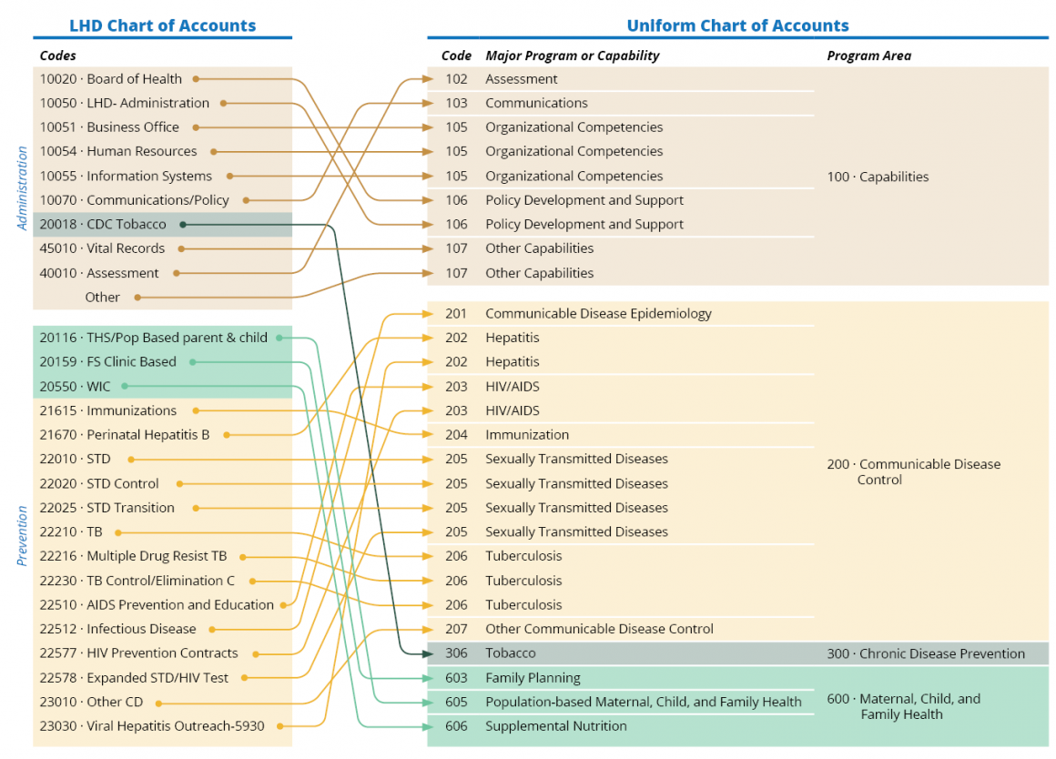
HOW IT WORKS: ALIGN
The Uniform Chart of Accounts (UCOA) complements—but does not replace—participating public health agencies’ COAs
Participating public health agencies will crosswalk—or map—financial information from their agency-specific COA to the UCOA
Financial information reported includes expenditures and revenues, broken down into key categories
Notes:
GREG
We piloted the uniform COA in 2015-2017 with 16 LHDs and 4 states
Nearly every agency could complete the crosswalking process and align their PH agency’s COA to the uniform COA

Slide 6
Capabilities |  | Program Areas
 |  | Communicable Disease Control | Chronic Disease Prevention | Injury Prevention | Environmental Public Health | Maternal, Child, and Family Health | Access to and Linkage with Clinical Care | Other Major Programs
All Hazards Preparedness And Response | Major Programs | Communicable Disease Epidemiology | Asthma | Firearms | Air | Coordination of Services | Eligibility Determination | Other Health Services
Assessment |  | Hepatitis | Cancer | Motor Vehicle | Fish and Shellfish | Direct Service | Health Care Licensing | Other Social Services
Communications |  | HIV/AIDS | Cardiovascular | Occupational Injuries | Food Safety | Family Planning | Other Access to and Linkage with Clinical Care
Community Partnerships Development |  | Immunization | Diabetes | Senior Falls Prevention | Hazardous Substances and Sites | Newborn Screening
Organizational Competencies |  | Sexually Transmitted Diseases | Obesity | Substance Abuse | Lead | Population-based Maternal, Child, and Family Health
Policy Development And Support |  | Tuberculosis | Tobacco | Other Intentional Injuries | On-Site Wastewater | Supplemental Nutrition
Other Capabilities |  | Other Communicable Disease Control | Other Chronic Disease Activities | Other Unintentional Injuries | Solid and Hazardous Waste | Other Maternal, Child, and Family Health
 |  |  |  |  | Water
 |  |  |  |  | Zoonotic
 |  |  |  |  | Other Environmental Public Health
Notes:
GREG
The COA includes expenditures and revenue data for 7 public health program areas and cross-cutting capabilities
Specified 50 major programs & capabilities with the help of our 20 pilot PH agencies
We tried to be as detailed as possible to avoid putting many activities into the “other” category.

Slide 7

JOIN
What LHDs get
Interactive data visualizations
Improved budgeting, performance management, & reporting
Comparisons across time & space
Clear information to understand & share total costs of programs & services
What LHDs do
View online training
Match data to COA format
Validate data with visualizations
25-30 hrs.
Notes:
GREG
Initial time investment was an average of 30 hours for our pilot LHDs, and many said they would expect it to take less time in the future
Depends on the PH agency’s current accounting system
So far 3 of our LHDs have signed up to do the COA again and one who wants to submit an extra year of data.

Slide 8

TIMELINE
Cohort 1
  Begin: September 2018
  End: March 2019
Cohort 2
  Begin: November 2018
  End: May 2019
Cohort 3
  Begin: January 2019
  End: July 2019
Cohort 4
  Begin: March 2019
  End: September 2019
Cohort 5
  Begin: May 2019
  End: September 2019
Notes:
MELINDA
This whole phase of the UCOA started in September with our first cohort of 7 agencies, and we are now up to 38 total from 17 states.
You all could be part of cohort 4, which includes 3 LHDs from 3 states. We’re using what we’ve learned from previous cohorts to improve training and TA for you all, and we will keep improving as we go along.
We will also likely have one additional cohort starting in May.

Slide 9
TIMELINE
Cohort 4
March ‘19:
Begin data entry
Sept ‘19:
Finalize data
May ‘19:
Finish data entry & begin validation
April ‘19:
Friendly TA check-in
Notes:
MELINDA
Here is a more detailed timeline for you all, cohort 4.
To make sure things go smoothly for you, we’d like to set up a “friendly TA” call with each LHD sometime in April.
Then in May after you’ve submitted your data, it will become available for you to review in visualizations on the training website. We want to know if the data appear to be accurate; but we’d also like feedback on how the data and/or visualizations could be used in practice, and suggestions for what might be added or changed to improve usefulness.

Slide 10
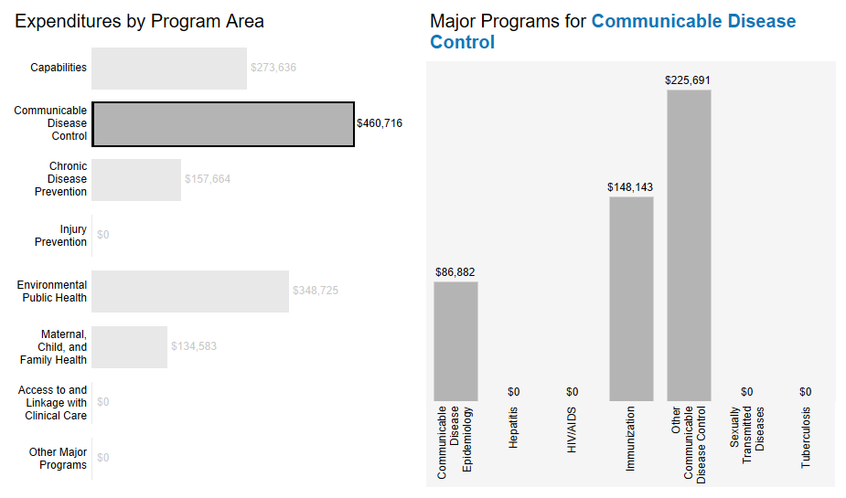
AGENCY OVERVIEW
Notes:
MELNDA
This shows data for a single LHD.
Each bar is a program area’s total expenditures
On the right, CD is broken down into the major programs’ expenditures
We also have the ability to look at total expenditures, revenue, and FTE.
Hovering over a bar gives more details, including any comments to explain what is included in “Other”

Slide 11
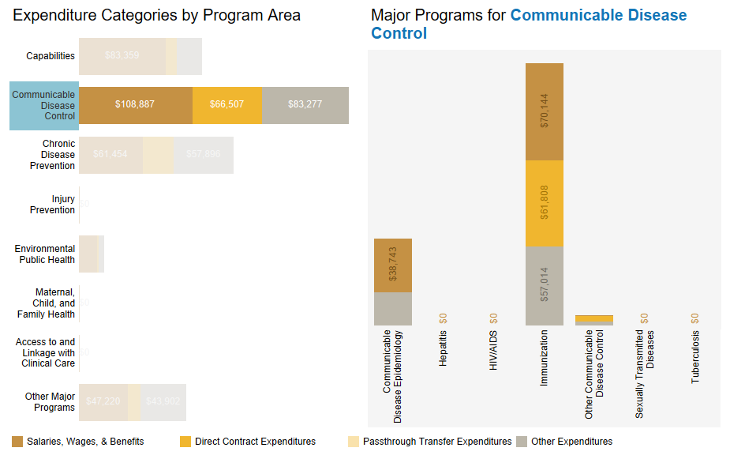
EXPENDITURES
Notes:
MELNDA
These are data from a different LHD
Each color represents a different expenditure category, and you can see that salaries makes up a good chunk of CD expenditures
Each major program is displayed when you click on the program area label, and it shows you how each major program’s expenditures break down

Slide 12
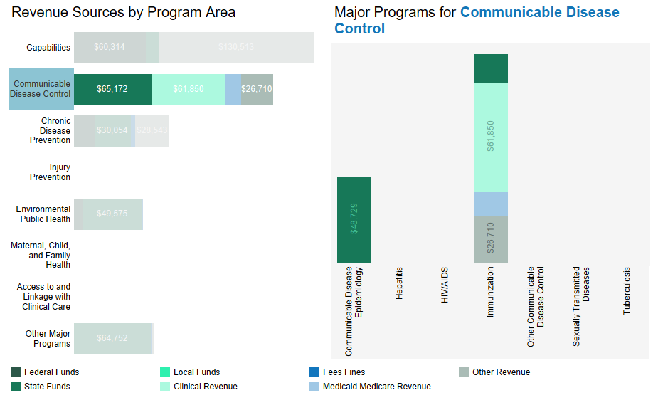
REVENUES
Notes:
MELNDA
This shows the revenue breakdown for the previous slide’s expenditures. You can see that the largest chunk of revenues comes from the state, followed by clinical revenues with a little bit of Medicaid/Medicare thrown in.

Slide 13
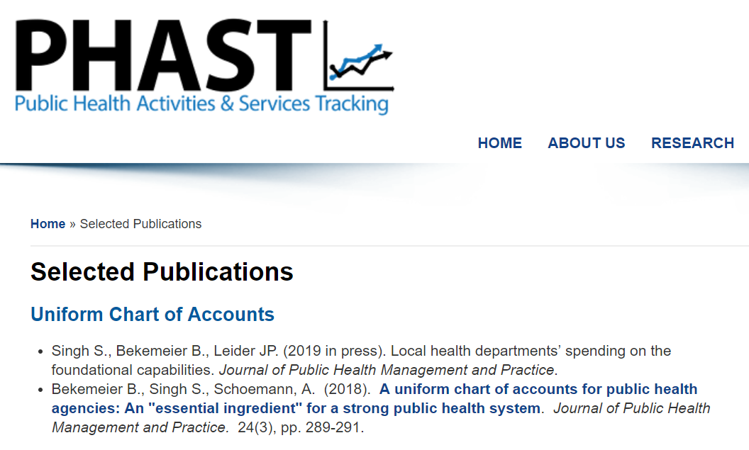
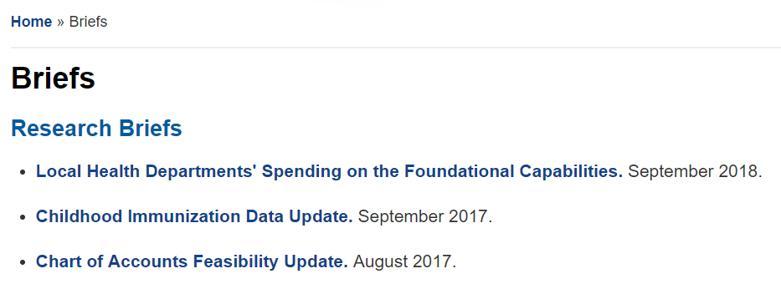
RESEARCH
Visit phastdata.org/research
Notes:
GREG

Slide 14
FAQs
Does the UCOA distinguish between foundational and non-foundational public health services?
  Uniform COA is based upon FPHS, but does not distinguish between foundational and non-foundational public health programs. Capabilities are all foundational.
How can a SACCHO get involved?
  Help recruit LHDs
  Assist with training/peer learning
What does the future of the UCOA look like?
  Project aims to explore how the UCOA can be implemented across LHDs
  PHAST team is exploring ways to make the UCOA sustainable with help of national organizations
Which LHDs can participate?
  Any interested LHD in the U.S.
What are the costs to LHDs?
    There are no costs besides the time LHDs need to spend to crosswalk their data to the uniform COA.
How many/which years of data do participating LHDs submit to PHAST?
  The most recently closed fiscal year
Are state health departments involved?
  This phase focuses on LHDs, but Alaska (a centralized state) has joined
Notes:
GREG

Slide 15
NEXT STEPS
Local Health Departments
SACCHOs
Contact us: phast@uw.edu
Review & sign MOU
Complete online training & crosswalking beginning in March 2019
Share our materials with your LHDs
Learn more about assisting PHAST with TA and administration
  Incentive payments available to SACCHOs
Learn more at our website: coa.phastdata.org
View public visualizations: phastdata.org/viz/coa-dashboard
Notes:
GREG
Our materials include a sample e-mail, newsletter text, an e-mail brochure, and a “social media kit” with sample graphics and text to distribute via Twitter and Facebook, etc.
Send email to phast@uw.edu and we will send you and MOU – you can review, ask questions, and once signed you’re part of the project

Slide 16

Questions?
E-mail Melinda Schultz
schulm5@uw.edu

Slide 17
PROJECT TEAM
Betty Bekemeier
Accounting & finance
Project director
Simone
Singh
Project director
Accounting & finance
Greg Whitman
Project manager
Melinda Schultz
Data management
Fred Abrahamson
Public health systems
Administration
JP Leider
Consultant
Public health systems & finance
Notes:
GREG

Slide 18
NATIONAL ADVISORY COMMITTEE
Liza Corso
PHNCI, PHAB
CB Mamaril
Kent State University
CDC
Ashley Edmiston
ASTHO
Jessica Fisher
Karl Ensign
NACCHO
Pamela Russo
RWJF
Matt Stefanak
Public Health Practice-Based Research Networks
Notes:
GREG

